Slide 1

Roll Your Own Stream Server
David Klann
Broadcast Tool & Die
broadcasttool.com
414.939.0841
dklann@broadcasttool.com
Notes:
This is a technical session. I’m going to be taking a deep dive into server setup, the Icecast streaming media server, a couple Icecast source clients and a word about HTTP Live Streaming (HLS)
-
Slides and other material are available …
-
So … The goal is: to ...

Slide 2


Notes:
Spin up a secure Icecast server on a public cloud server
-
Does everyone know the basic idea of Icecast (details if necessary)
-
Low Level: Use automation (cloud-init) to quickly and easily spin up a server, set up secure access, add administrative users, and install all apps – the end result is an Icecast server ready to go
-
Visually, the setup looks something like this. First, you need an audio source … Like, … I dunno ...

Slide 3
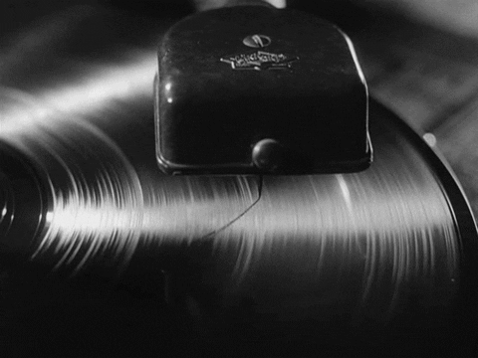
Notes:
Oh! You already have this – a radio station!
-
-
Then you need to hook...

Slide 4
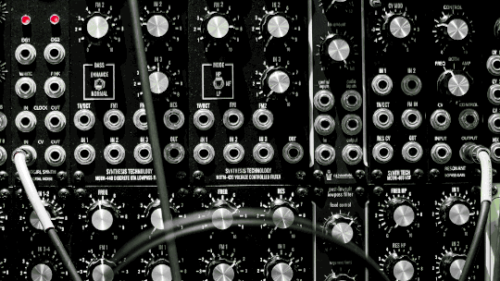
Notes:
it all up …
-
send it ...

Slide 5

Notes:
to the cloud…
-
and then get lots ...

Slide 6

Notes:
...of listeners!
-
Hmmmmmm…. How do you do that? …
-
(Not “get the listeners” part, but the “set it up” part). . .
-
Let’s define some terms ...

Slide 7
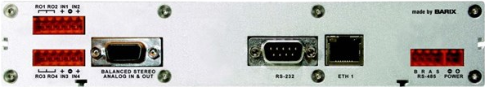
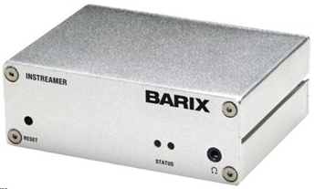
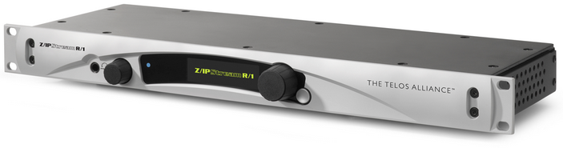
Source Clients
Notes:
Icecast is a client-server app. Listeners are “clients” of the icecast “server”.
-
Things that feed the icecast server are also “clients”.
-
The “feeders” are called “source clients”. Kind of unfortunate terminology, but it is what it is...
-
- <CLICK>
-
“source clients” are dedicated hardware, or software apps that feed digital audio (and/or video) to the icecast server
-
Of course there are the commercial offerings: Comrex, Barix, Telos, etc., etc.
-
But how about a home-grown solution to match . . .

Slide 8

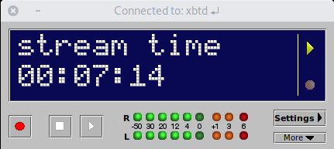
Source Clients
https://liquidsoap.info/
http://danielnoethen.de/butt/
Notes:
. . . your self-hosted Icecast server! You have a few options:
-
Liquidsoap – a cross-platform (Linux & Windows [possibly MacOS via HomeBrew]) command-line stream scripting engine that can feed Icecast, HLS, or just about anything you might want to do!
-
BUTT – a cross-platform (Linux, Windows & MacOS) GUI source client for Icecast
-
Lots of others exist, including commercial offerings, but these are the most popular combination encoder and source client.
-
For any source client, you need an audio source (often analog audio that comes in thru the PC sound card) and somewhere to send the encoded audio.
-
With that intro out of the way, let’s get our Icecast server ready to accept source client connections...

Slide 9
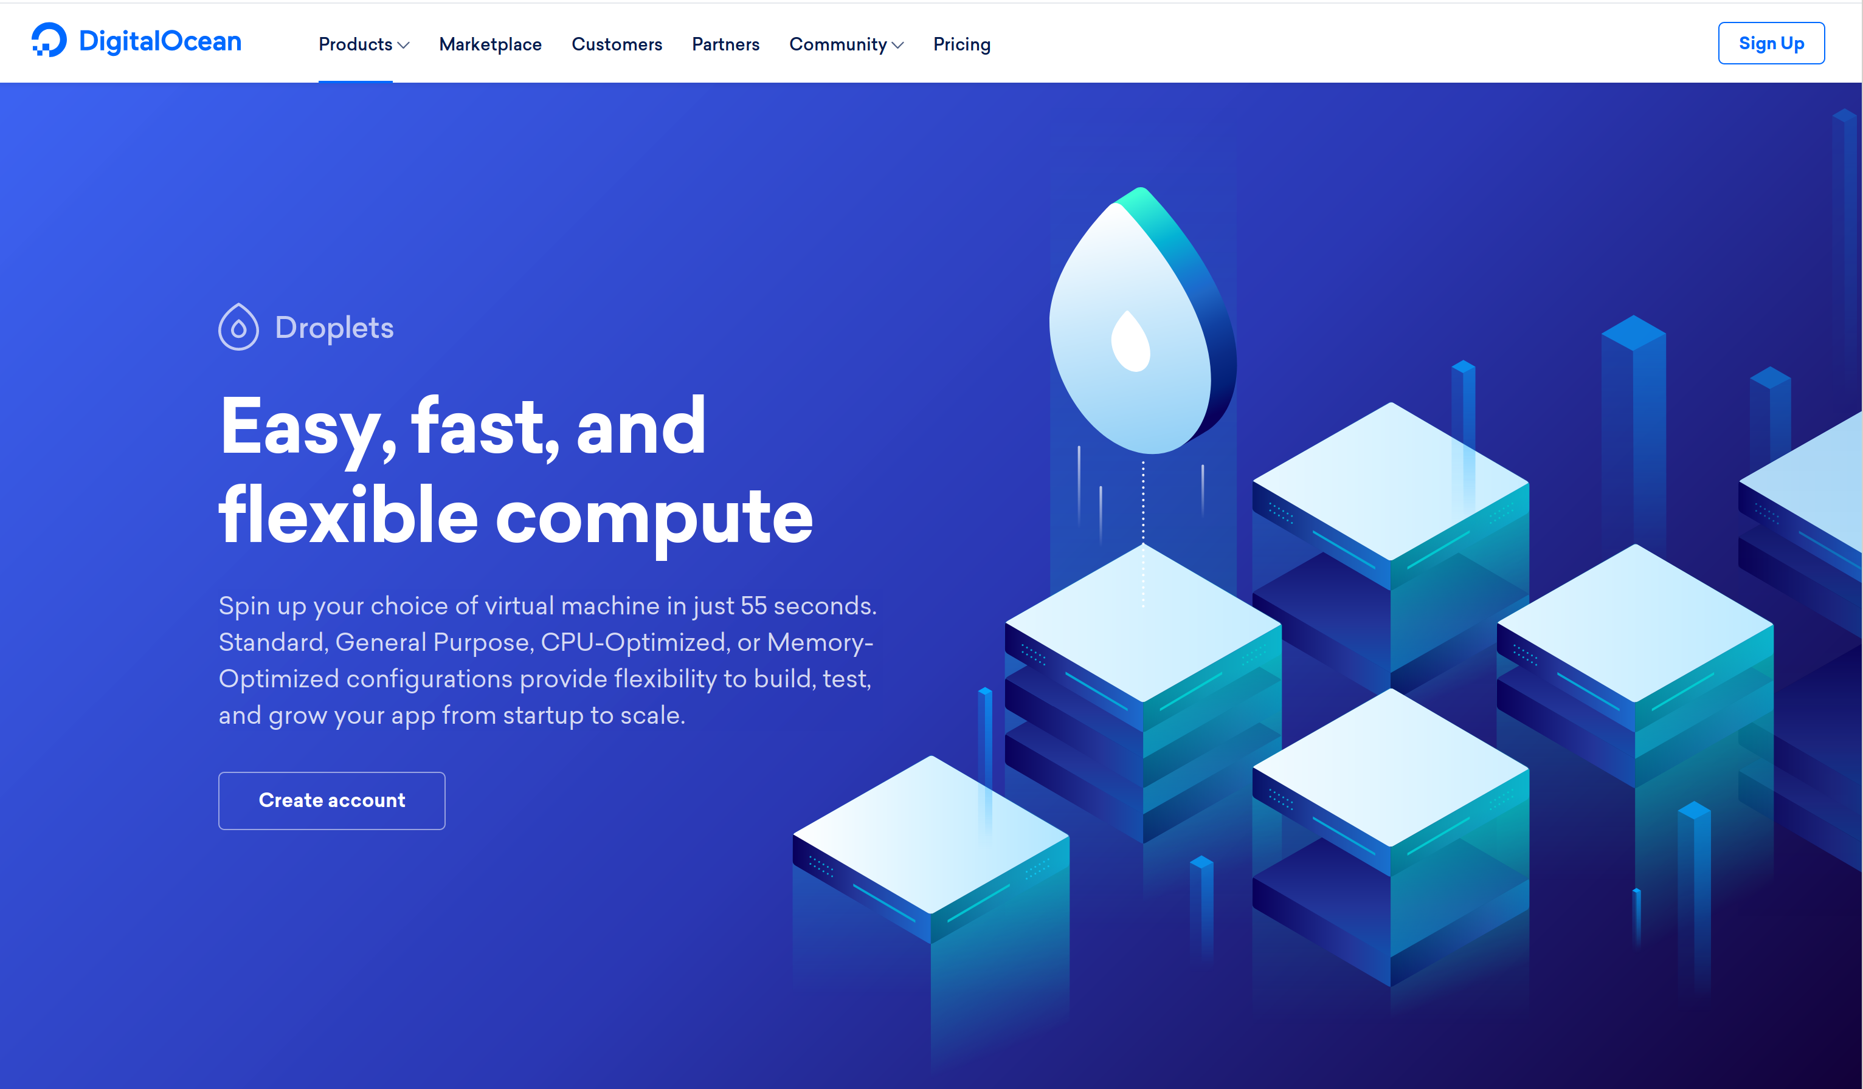
Where do I put this thing?
Notes:
… First we need an account at a cloud provider.
-
TONS of hosting providers. The main thing is to choose a hosting provider that offers complete control of the virtual machine (not a “web host” provider like Square Space or WIX or WordPress), and supports the “cloud-init” functionality for their Linux systems (most do).
-
There are several good cloud providers, including
-
… Digital Ocean ...

Slide 10
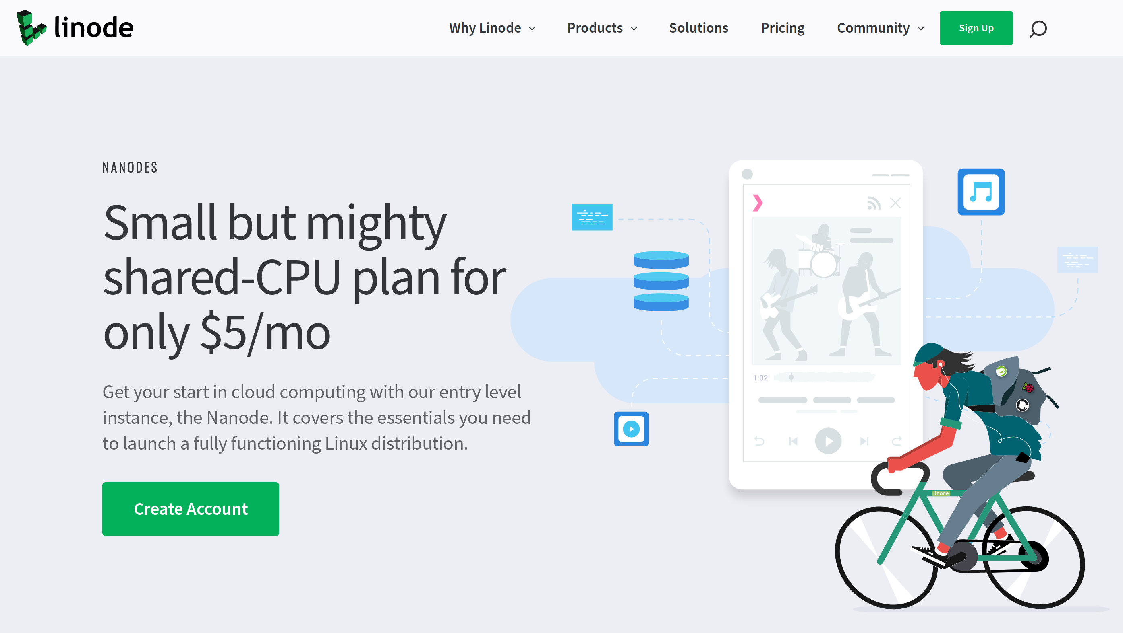
Here?
Notes:
... Linode, ....

Slide 11
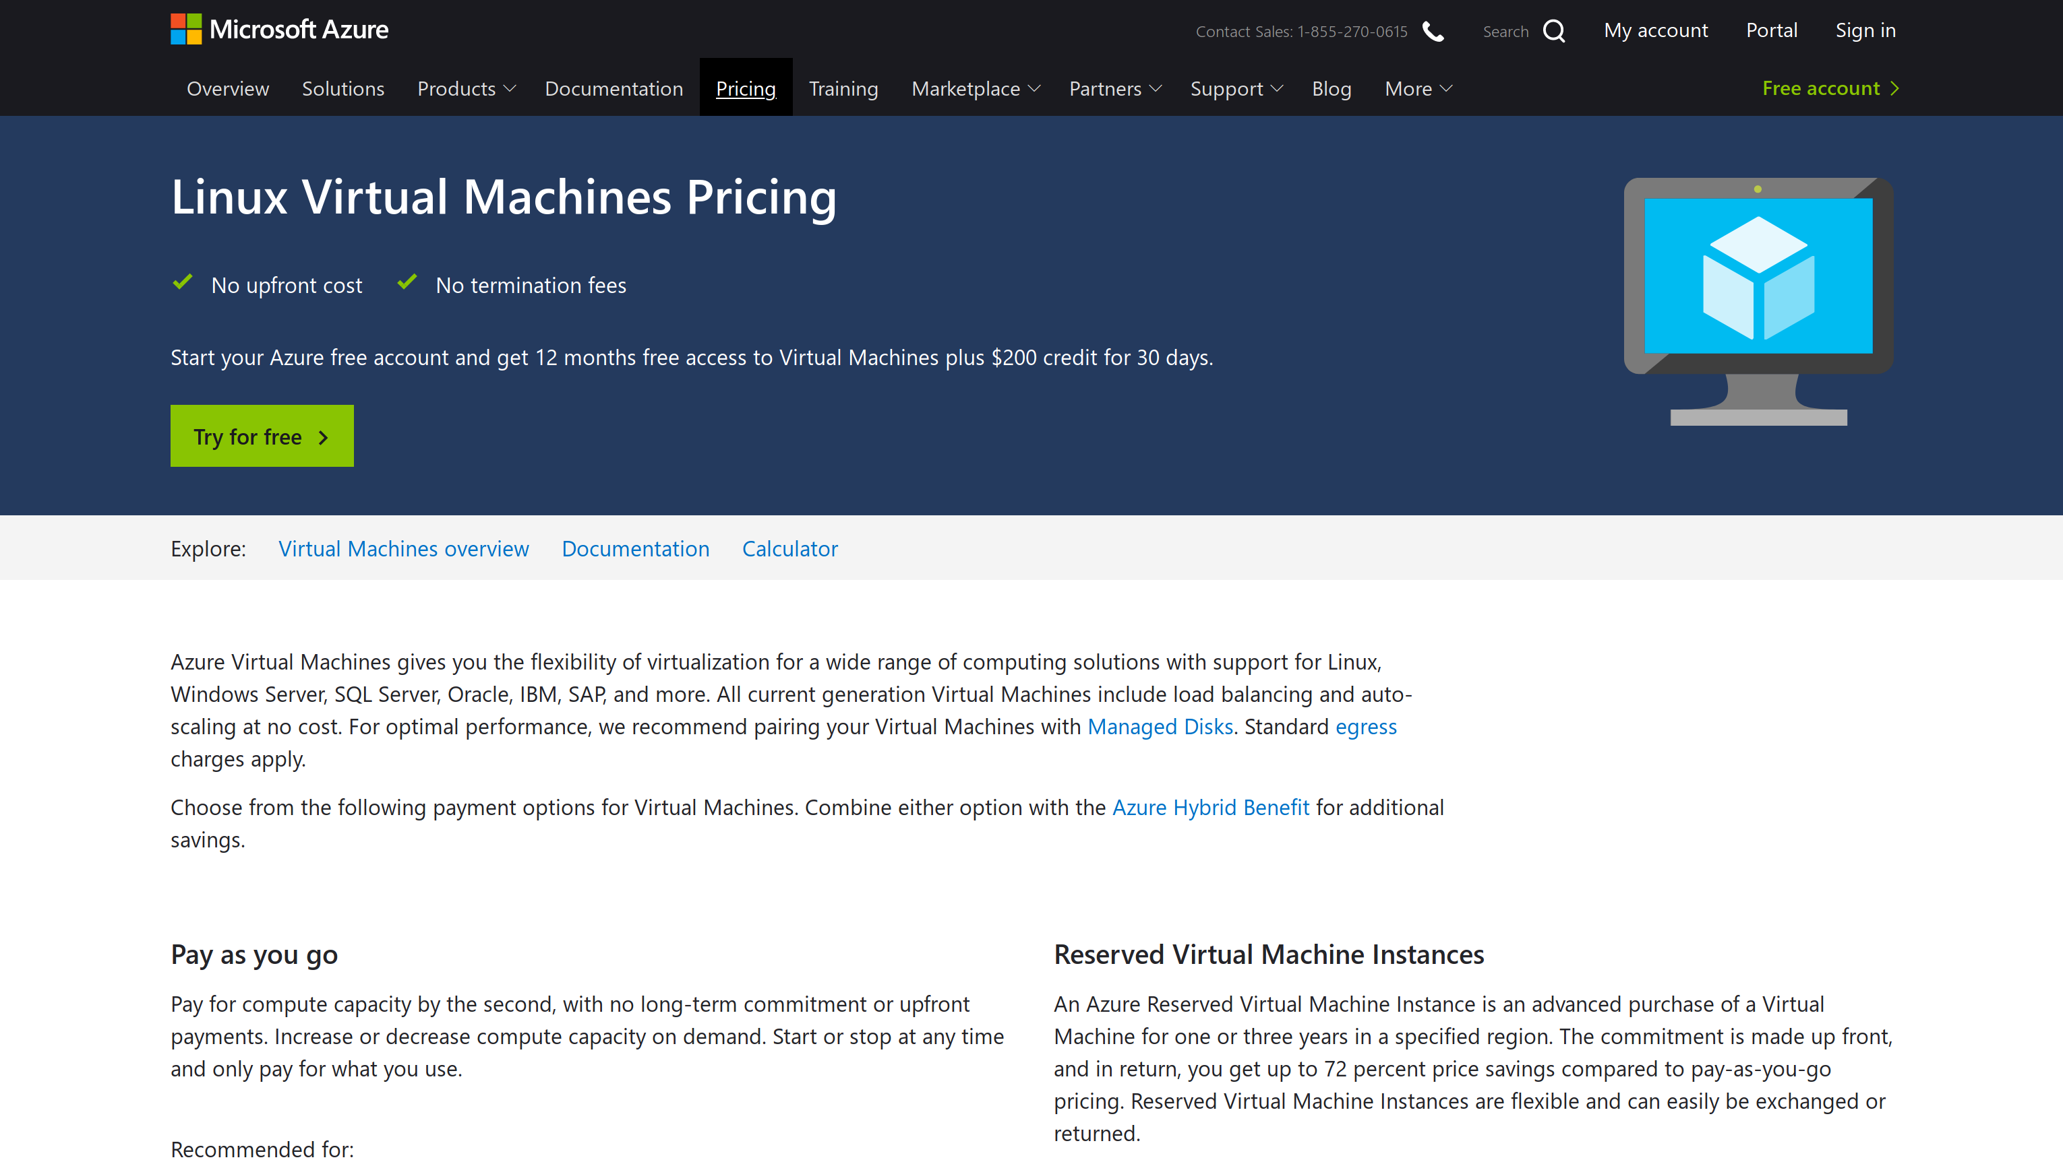
Or Here?
Notes:
… Microsoft Azure, etc.

Slide 12




Yikes! Too many to choose from!
Notes:
… etc., etc. …
-
What we’re going to do is create a virtual machine (or VM) at the hosting provider. So you’ll need to set up an account. Have your credit card in hand because we’re going to spend some money on a virual machine (they won’t charge you until you create your first VM)...
-
I’ll use Digital Ocean as an example, but as I said, they’re all pretty similar.
-
I’ll start on the assumption that you’ve already got an account, and you’ve chosen to create a new “droplet” (their term for VM). . . Oh! For some perspective . . .

Slide 13
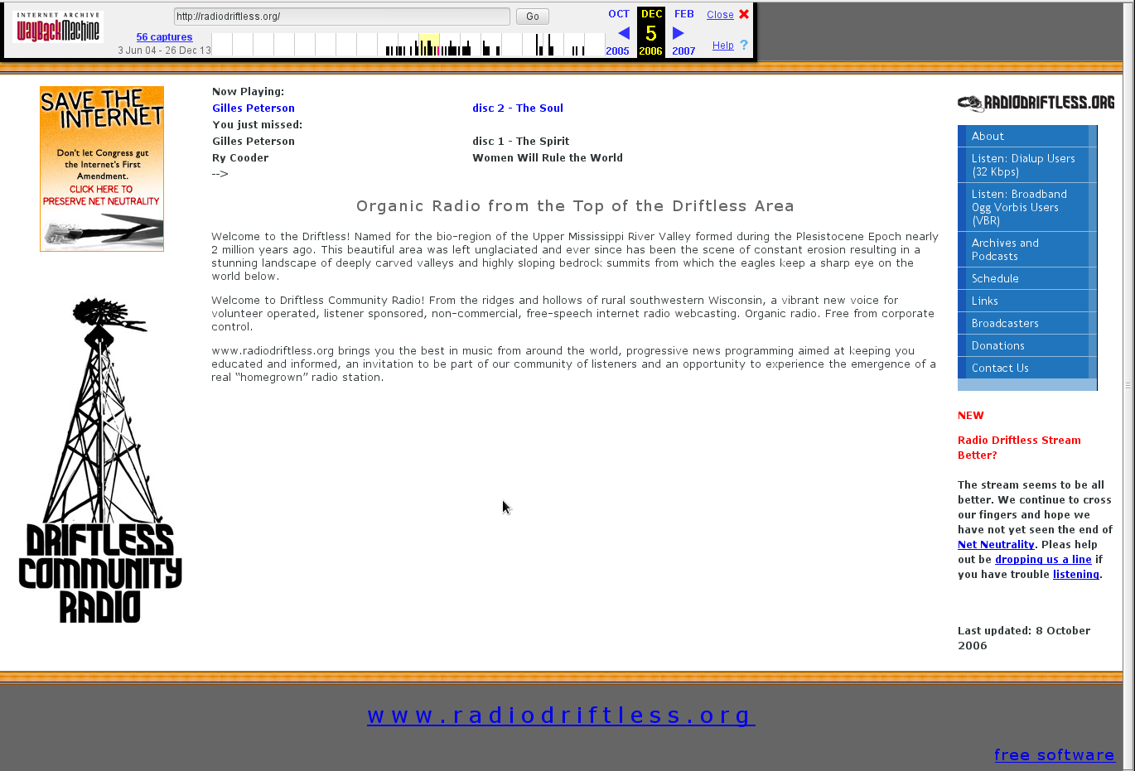
Notes:
Here’s a view of the website for one of my streaming stations in 2006.
-
Even 13 years ago we were using Icecast!

Slide 14
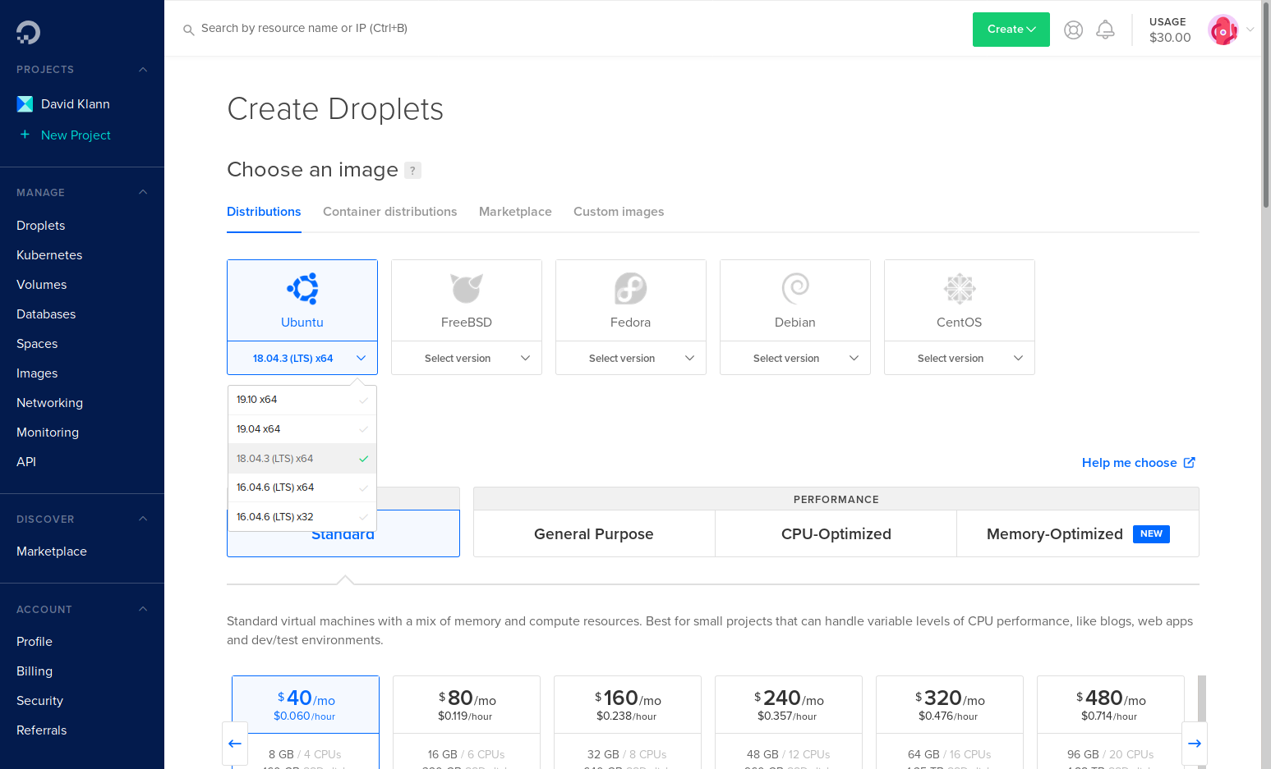
Notes:
-
Start by choosing the OS to install. All of them work fine, but Ubuntu has amazing community support and all the necessary packages ready to go…
-
The “Standard Plan” is set by default.
-
Then choose the size. Beware that they try to steer you to the higher-priced VMs so scroll that horizontal list to the right…

Slide 15
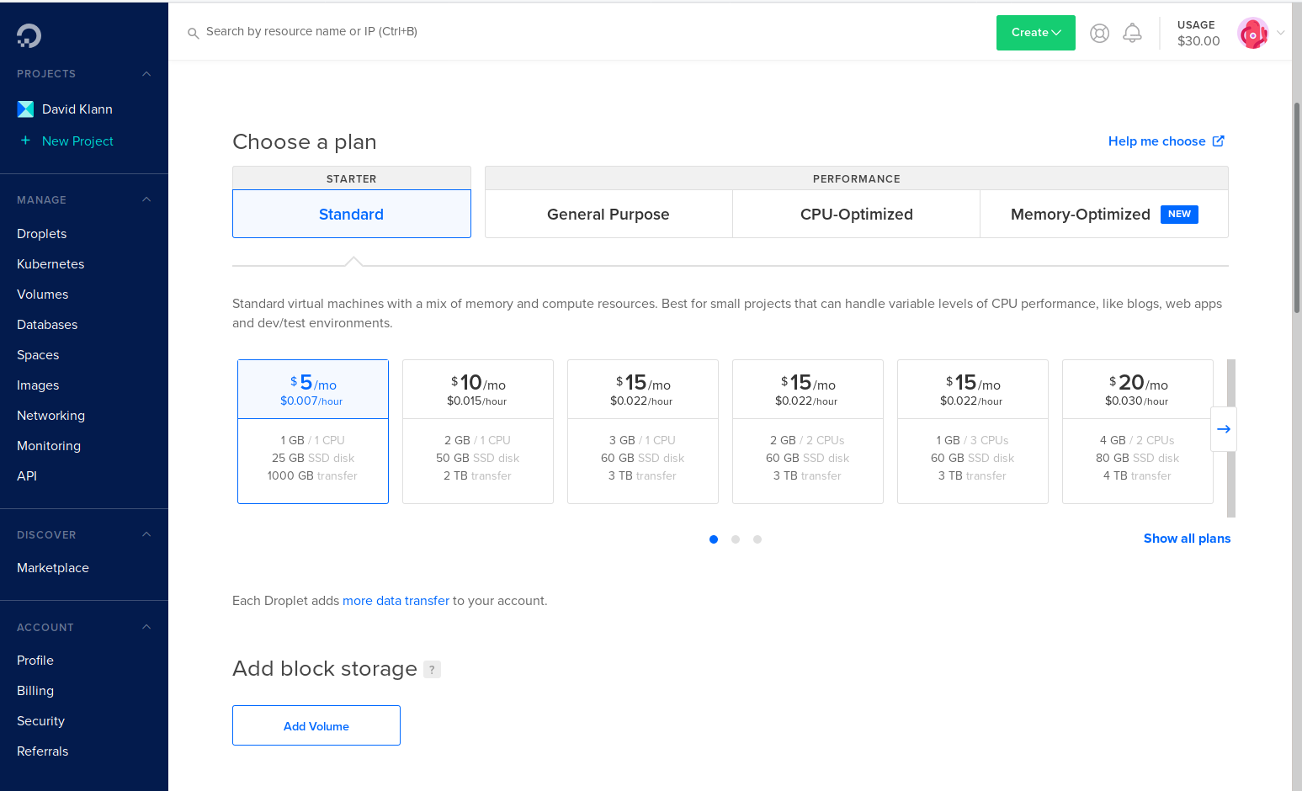
Notes:
… and choose the smallest five dollar VM. It’s got plenty of resources and power to host a moderate number of listeners.
-
Next, we have to choose our server’s location. In the case of Digital Ocean, . . .

Slide 16
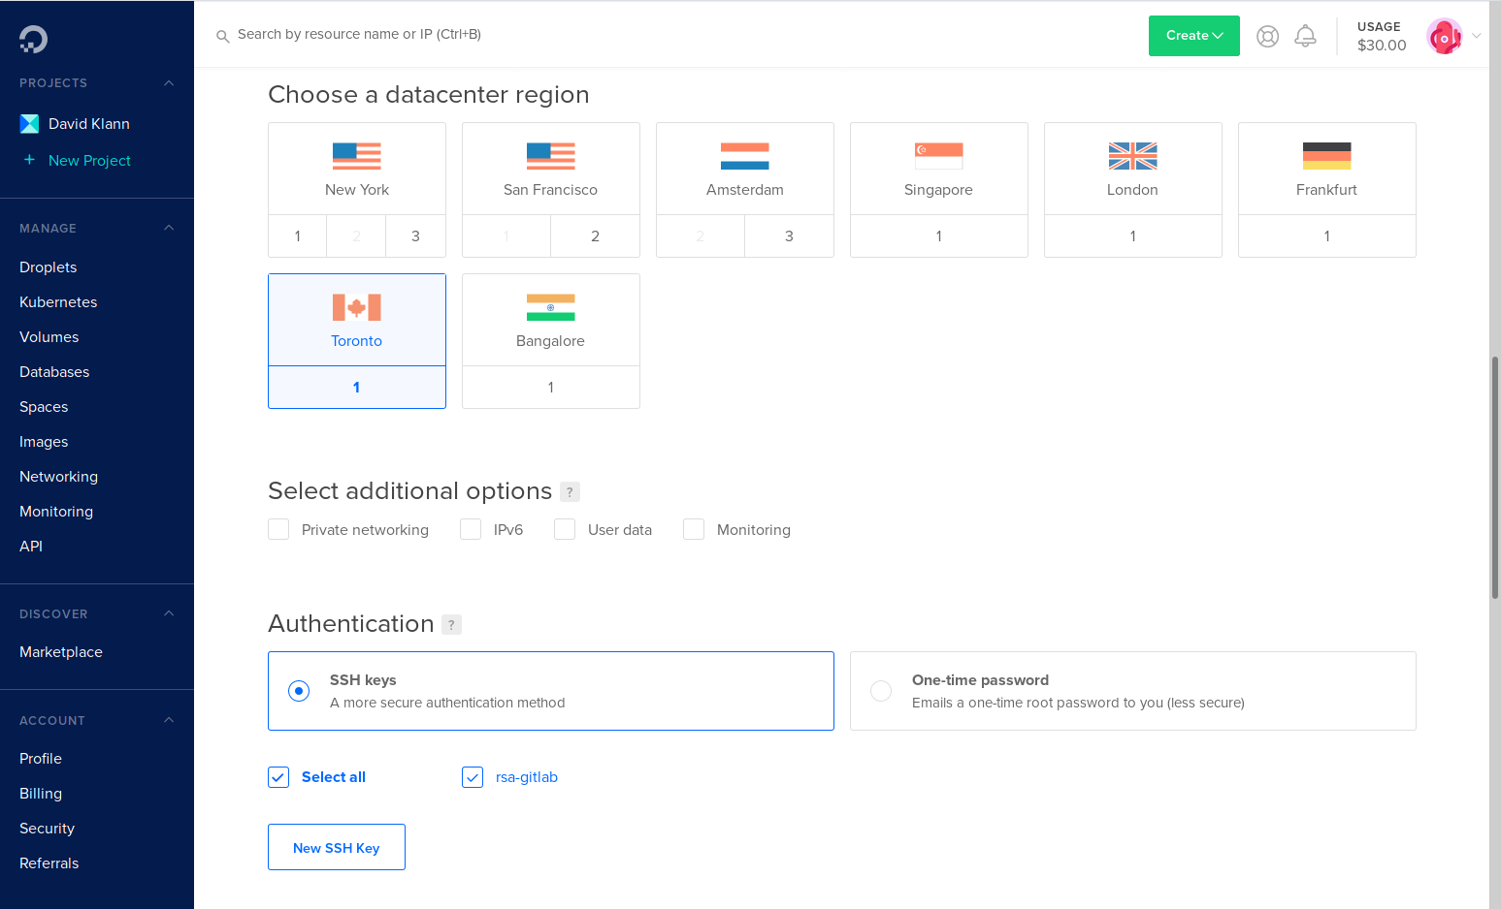
Notes:
the region where you want to run your VM. Closer to your listeners is better, but it doesn’t matter all that much where it is geographically.
-
Next we come to the crux of the new VM. . .

Slide 17
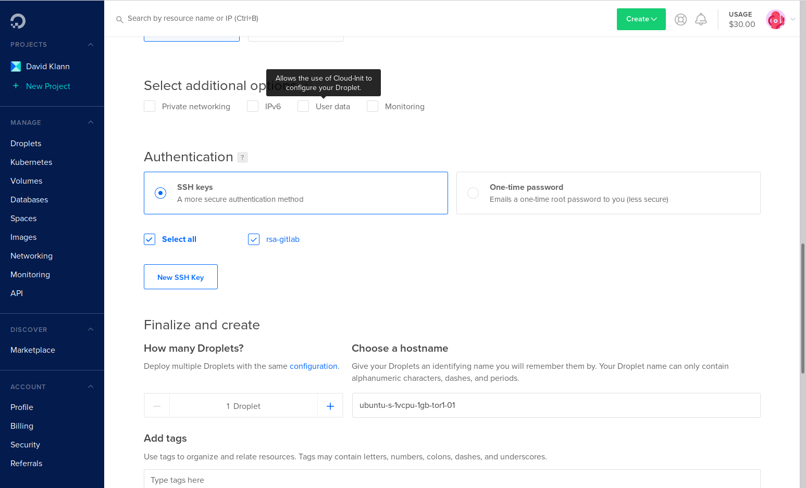
Notes:
. . . This is where we get to describe all the customization we need in order to make this an Icecast virtual machine. Up to this point all we’re doing is making a generic server.
-
Watch what happens when we check this box.
. . .

Slide 18
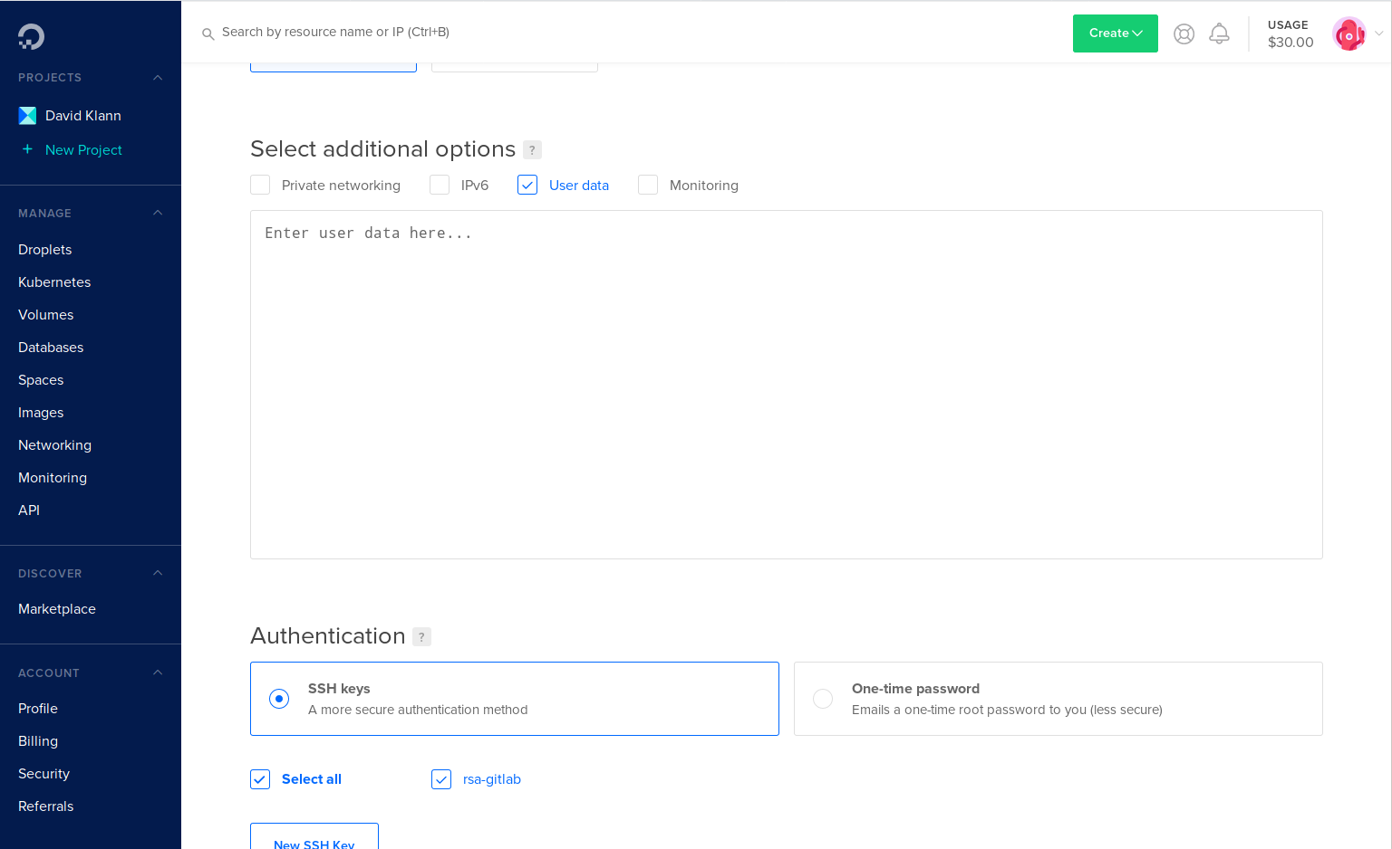
Notes:
We have this big text box that opened up and lets us enter lots of stuff. . .
-
User data is better described as “customization instructions”. I’ll get into the specifics in a minute
-
Let’s get thru the rest of the options for creating the server . . .

Slide 19
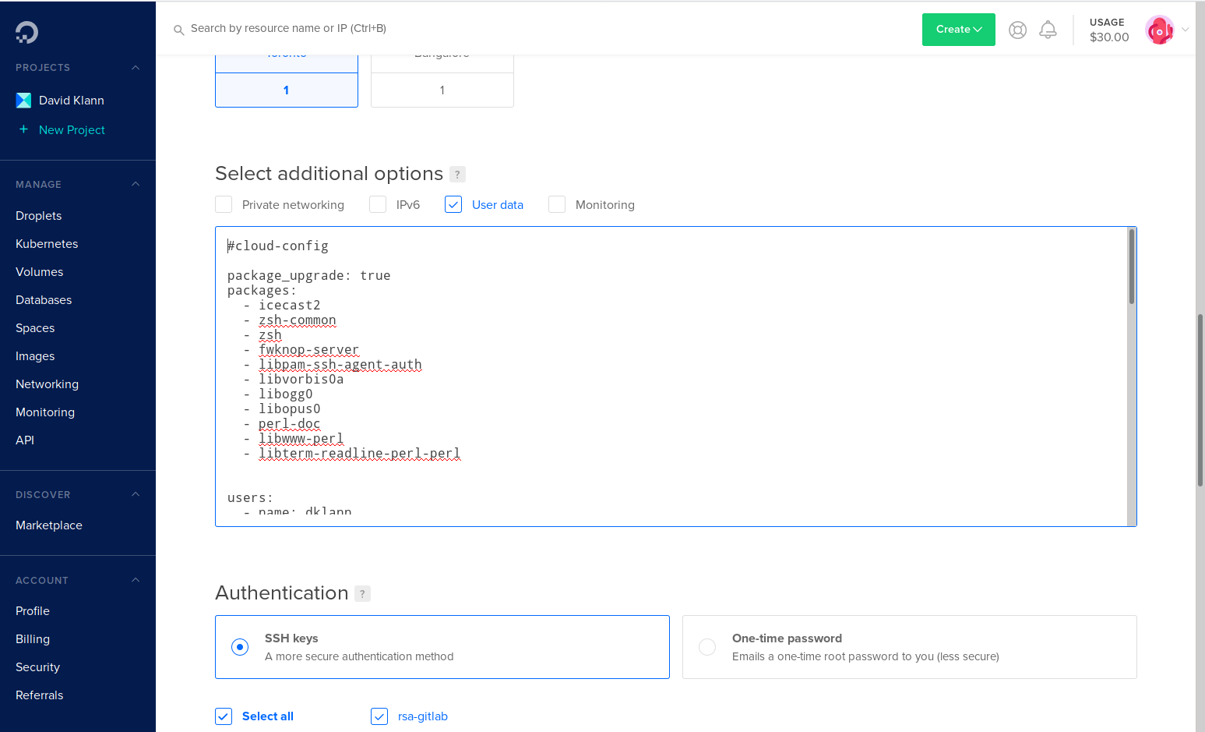
Notes:
…
-
…
-

Slide 20
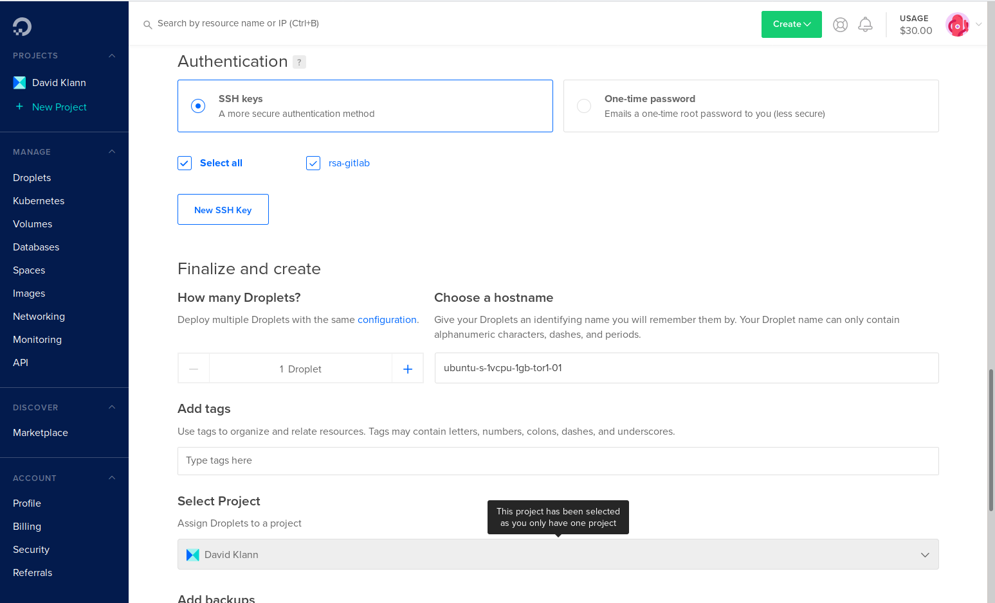
Notes:
There are use cases where one might want to spin up dozens or hundreds of identical Vms. A single icecast server is not one of those use cases, so leave the count at “1”
-
The virtual machine name is more or less an internal thing, so don’t feel like you have to change it. The default is helpfully descriptive.
-
And finally, . . .

Slide 21
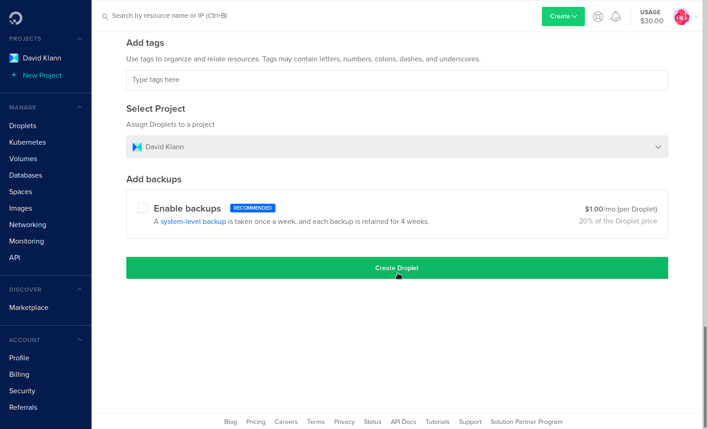
Notes:
. . . we’re ready to create the virtual machine. Just click “Create Droplet” and we’re off. . .
-
It’ll take a couple minutes to allocate the machine and run our “user data” commands. When it’s done it will show you the droplet’s IP address and give you a control panel for the new virtual machine.
-
Let’s get into the details of the “user data”. . .

Slide 22
#cloud-config
package_upgrade: true
packages:
- icecast2
- zsh-common
- zsh
- fwknop-server
- libpam-ssh-agent-auth
- libvorbis0a
- libogg0
- libopus0
- perl-doc
- libwww-perl
- libterm-readline-perl-perl
Notes:
I’ll show this on 3 or 4 slides, just so you can see the text. . .
-
User data consists of general instructions to the cloud init system running on your new VM. Our User Data has three sections: the first is package installation.
-
The second section . . .

Slide 23
users:
- name: dklann
gecos: David Klann
groups: sudo
shell: /bin/zsh
ssh-authorized-keys: ssh-rsa AAAAB3NzaC1yc2EAAAA…
ssh-authorized-keys: ssh-ed25519 AAAAC3NzaC1l...
Notes:
Describes any Linux users we want to add during installation
-
And the third section . .

Slide 24
runcmd:
# Configure sudo to support SSH agent authorization:
# Part 1 update /etc/pam.d/sudo
- sed -i -e '1aauth sufficient pam_ssh_agent_auth.so ...
# Part 2: update /etc/sudoers
- sed -i -e '/^# Host alias specification/iDefaults ...
# Secure root SSH access
- sed -i -e '/Port /s/^.*$/Port 32808/' -e '/^PermitR...
- sed -i -e '/^ports=/s,^.*$,ports=32808/tcp,' /etc/u...
- ufw app update OpenSSH
- systemctl restart ssh.service
- ufw allow OpenSSH
- echo ‘[Icecast 8282]\ntitle=Icecast on port 8282...
- ufw app update 'Icecast 8282'
- ufw allow 'Icecast 8282'
- systemctl enable ufw.service
- echo 'y' | ufw enable
...
Notes:
Describes all other modifications we want to make to the software on our new VM.
-
(high level walk thru of the mods...
-

Slide 25
...
Configure the icecast server
- sed -i -e 's,\(<source-password>\).*\(</source-pass...
- sed -i -e 's,\(<port>\).*\(</port>\),\18282\2,' /et…
- sed -i -e ‘s,ENABLE=false,ENABLE=true,’ /etc/default/icecast2
- systemctl enable icecast2.service
# Set the timezone appropriately
- rm /etc/localtime
- ln -s /usr/share/zoneinfo/US/Central /etc/localtime
- timedatectl set-timezeone US/Central
# Reboot after doing everything above
power_state:
timeout: 90
message: Rebooting in five minutes. Please save your work.
mode: reboot
Notes:
. . . and the rest of the modifications to the system . . .
-
. . .
-
When we’re all done, we can open a virtual terminal window to our new server . . .

Slide 26
user-data
#cloud-config
package_upgrade: true
packages:
- icecast2
- libpam-ssh-agent-auth
- libterm-readline-perl-perl
- libwww-perl
- perl-doc
- zsh
- zsh-common
users:
- name: dklann
gecos: David Klann
groups: sudo
shell: /bin/zsh
ssh-authorized-keys: ssh-rsa AAAAB3NzaC1yc2EAAAADAQABAAACAQDM...
ssh-authorized-keys: ssh-ed25519 AAAAC3NzaC1lZDI1NTE5AAAAIIQj...
runcmd:
# Configure sudo to support SSH agent authorization:
# Part 1 update /etc/pam.d/sudo
- sed -i -e '1aauth sufficient pam_ssh_agent_auth.so file=~/.ssh/authorized_keys' /etc/pam.d/sudo
# Part 2: update /etc/sudoers
- sed -i -e '/^# Host alias specification/iDefaults env_keep += "SSH_AUTH_SOCK"' /etc/sudoers
# Secure root SSH access and enable the service
- sed -i -e '/Port /s/^.*$/Port 2222/' -e '/^PermitRootLogin/s/^.*$/PermitRootLogin without-password/' … /etc/ssh/sshd_config
# This is here as an example of configuring an application for UFW
- sed -i -e '/^ports=/s,^.*$,ports=2222/tcp,' /etc/ufw/applications.d/openssh-server
- ufw app update OpenSSH
- ufw allow OpenSSH
- systemctl enable ssh.service
- systemctl enable ufw.service
- echo 'y' | ufw enable
# Set the timezone appropriately
- rm -f /etc/localtime
- ln -s /usr/share/zoneinfo/US/Central /etc/localtime
- timedatectl set-timezone US/Central
# Reboot after doing everything above
power_state:
timeout: 90
message: Rebooting...
mode: reboot
Notes:
… First we need an account at a cloud provider. (I’m skipping that for this session and using a local virtual machine on my laptop.) The main thing is to choose a hosting provider that supports the “cloud-init” functionality in their Linux systems (most do).
-
For the cloud-init part we need a “user-data” file that contains the initial instructions to get the system up and running.
-
Apologies for the eye chart, and the actual file is a bit larger than this...
-
This tells the installer to add things like packages, users, and to do other customization we want to take place while the system is installing our VM…
-
The third part combines these two things (meta-data and user-data) into an image that the virtualization system can use while building the VM.
-
The fourth part is a pre-built “cloud image” file that you can get from any of the popular Linux distribution creators. We’ll use ...

Slide 27
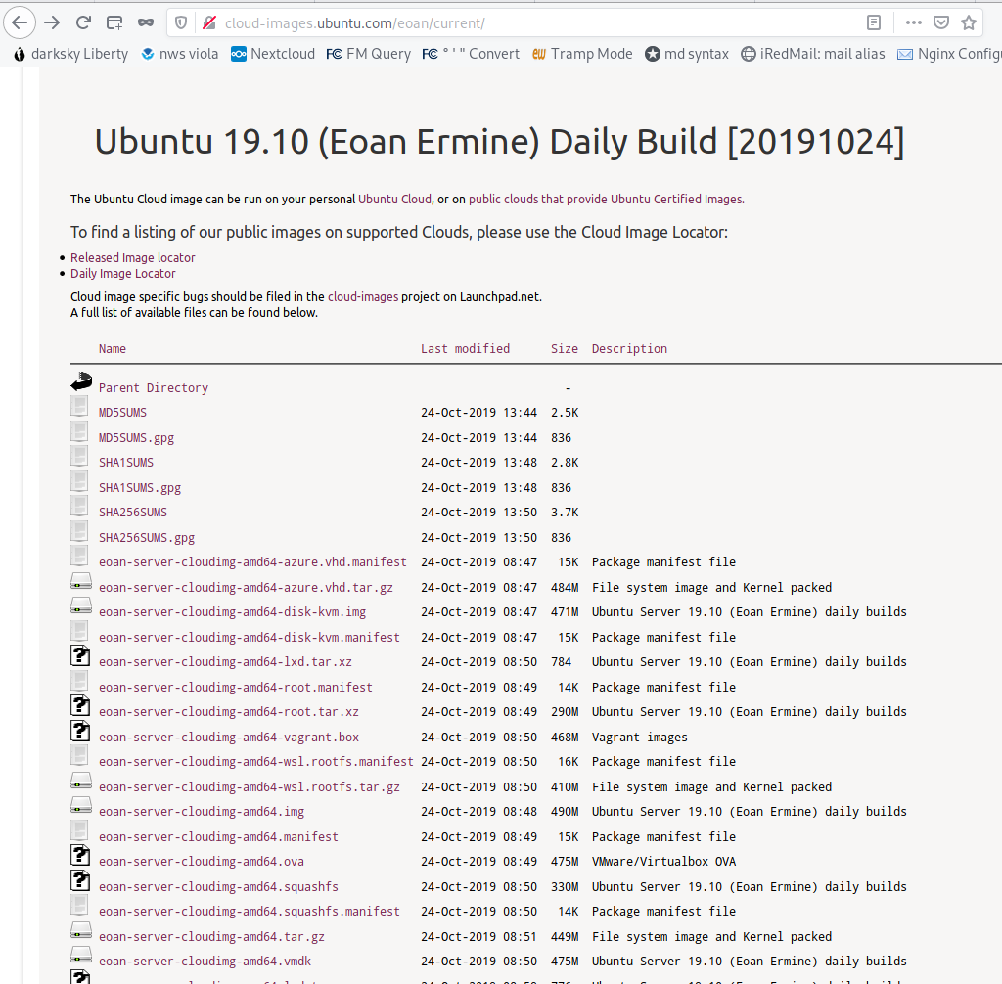
Cloud Image
Notes:
… Ubuntu for this session…
-
Since we like to live on the bleeding edge, I’ve chosen the latest Ubuntu image, AND the daily build of that image…
-
So. We now have our …

Slide 28



Cloud Image
user-data
Ubuntu Image
Notes:
… So. We now have our …
-
user-data, and our …
-
Ubuntu image,
-
All packaged up and ready to launch.
-
In my experience, this takes about a minute, and we end up with ...

Slide 29
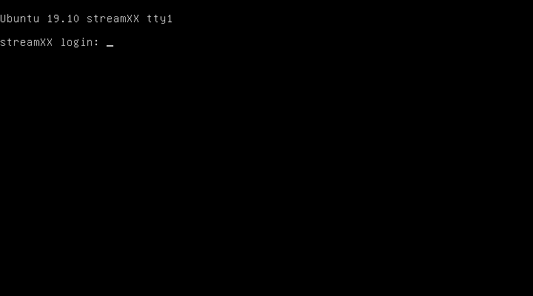
Cloud Image
Notes:
. . . and log in
-
If we were to log in and look at the Icecast configuration, we’d see . . .
. . .

Slide 30
Source Clients
…
<authentication>
<!-- Sources log in with username 'source' -->
<source-password>
sooper_sekrit_source_client_password
</source-password>
...
Notes:
this section with the source password
-
Bonus Points: can anyone tell what file format this is?
-
So now we have a way for our source client to authenticate to the icecast server.
-
We would also see the . . .

Slide 31
Source Clients
…
<!-- You may have multiple <listener> elements -->
<listen-socket>
<port>8282</port>
</listen-socket>
...
8282
Notes:
… TCP port for the source client to connect on
-
(Don’t worry about taking copious notes on this. In case you haven’t seen it, there’s a template icecast.xml file on the github project site.)
-
Also, note that the source client connects on the same TCP port as the regular listener clients. You *can* set a different port for the source client, but it’s not necessary. (We’ll ignore HTTPS for this session.)
-
That’s basically all you need to do to get the icecast server up and running!
-
Now let’s take a closer look at the source client setup. We’ll start with ...

Slide 32
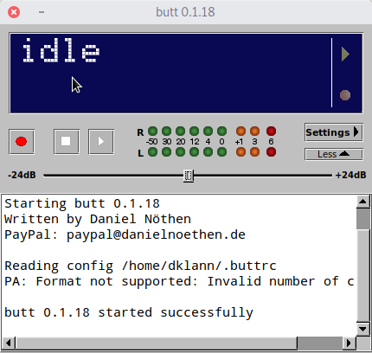
Source Clients
Notes:
B.U.T.T. …
-
This is the view of BUTT when you first launch it. Let’s take a look at the ...

Slide 33
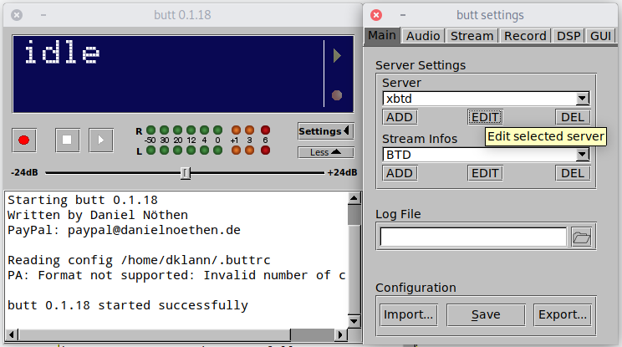
Source Clients
Notes:
Settings window and get things set up.
-
Click the ADD or EDIT button to add or change the settings ...

Slide 34
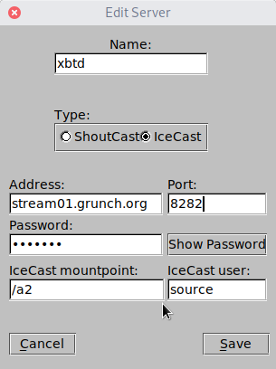
Source Clients
<port>8282</port>
<source-password>
sooper_sekrit_source_client_password
</source-password>
Notes:
The first view is the collection of settings to connect to the stream server...
-
Set the source password and port ...
-
After you click “Save” you’ll see this tabbed window ...

Slide 35
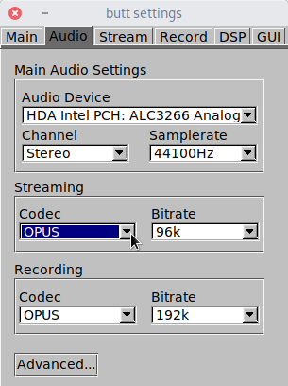
Source Clients
Notes:
With the other settings.
-
Set these as desired… (MP3 vs Others)
-
In the “Stream” tab ...

Slide 36
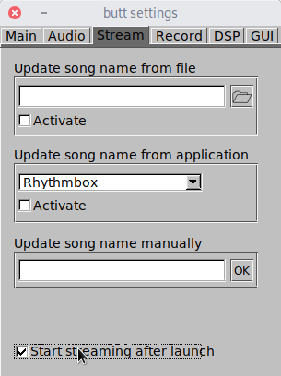
Source Clients
Notes:
be sure to tick the “Start streaming ...” checkbox so BUTT connects to the stream server as soon as you launch it.
-
In the “Record” tab ...

Slide 37
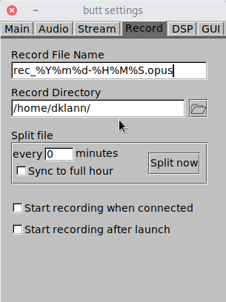
Source Clients
Notes:
you can select these options to keep an archive of your station’s audio. I usually use a separate tool for that, but ...
-
Recent versions of BUTT include a small equalizer ...

Slide 38
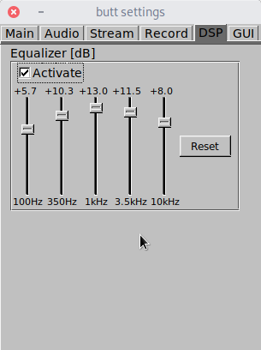
Source Clients
Notes:
… with which you can tweak the sound of your stream. It doesn’t replace conventional audio processing, but it might be just enough for your stream.
-
The settings in the last tab, GUI ...

Slide 39
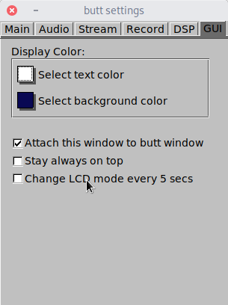
Source Clients
Notes:
… simply let you tweak the appearance of BUTT…
-
IMPORTANT!!!
-
After setting things the way you want them, you need to save the configuration.
-
Switch back to the “Main” tab ...

Slide 40
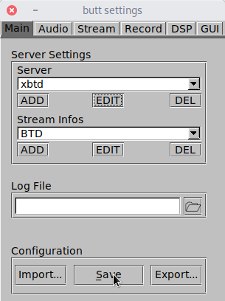
Source Clients
Notes:
… and click “Save”.
-
ALSO IMPORTANT!!!
-
You need to actually START the source client streaming after changing all the settings.
-
Close the Settings window and ...

Slide 41

Source Clients
Notes:
… and click the “Play” button…
-
You should see the BUTT app connect ...

Slide 42
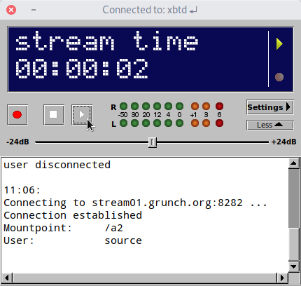
Source Clients
Notes:
… after a few seconds…
-

Slide 43
HLS Streaming
HLS is actually only one of these: HTTP(S)
Use nginx as a reverse proxy and “feeder” of HLS files
Requires this GitHub project for the nginx RTMP module
Icecast is the source for the HLS stream OR:
LiquidSoap
GlassCoder
Here is a sample nginx HLS configuration
uses three different bitrate streams: 32k, 64k, & 128k AAC

Slide 44







The Interwebs

Slide 45

Roll Your Own Stream Server
David Klann
Broadcast Tool & Die
broadcasttool.com
414.939.0841
dklann@broadcasttool.com

